Slide 1
Biophysical Communication
Unique ways the body communicates

Slide 2
What communciates
Nerves
Hormones
Fascia Collagen
Infra-sound
Bio-magnetite
Biophoton
Water

Slide 3
Water

Slide 4
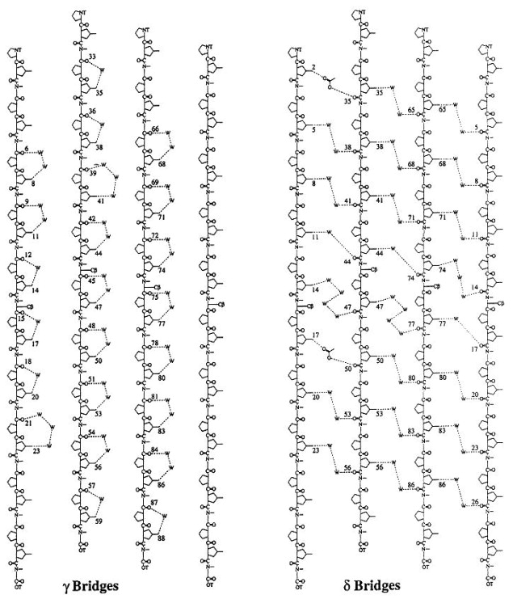
Water Bridges in Collagen

Slide 5
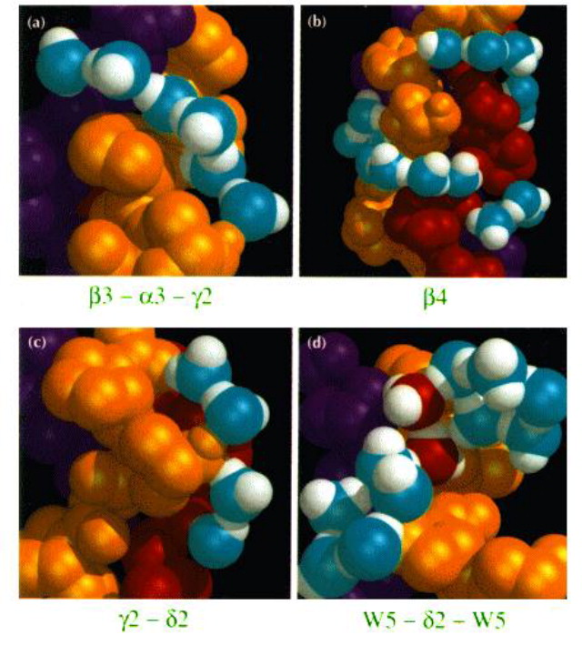
Stacked Water in Collagen

Slide 6
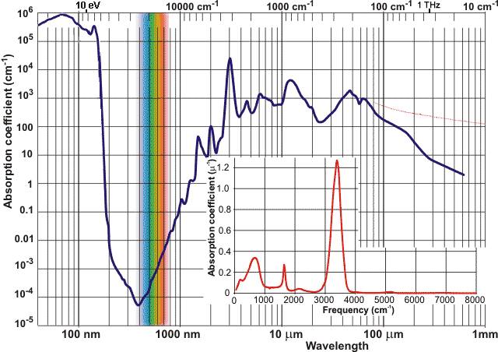
Water EMF Absorption

Slide 7
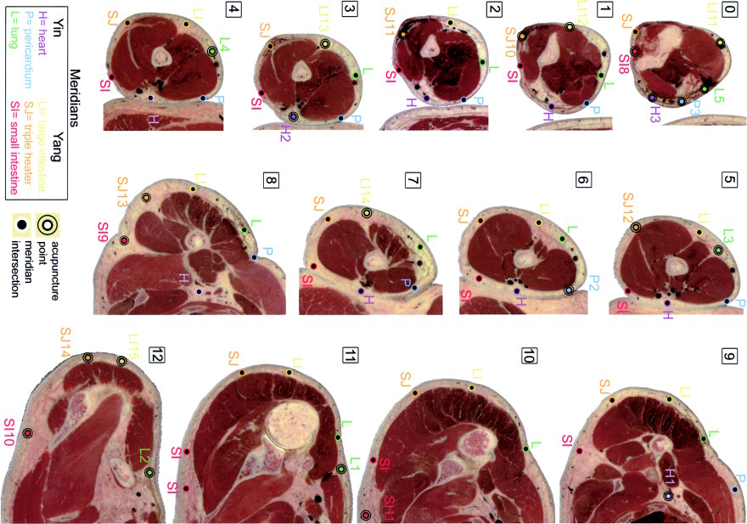
Acupuncture points / connective tissue

Slide 8
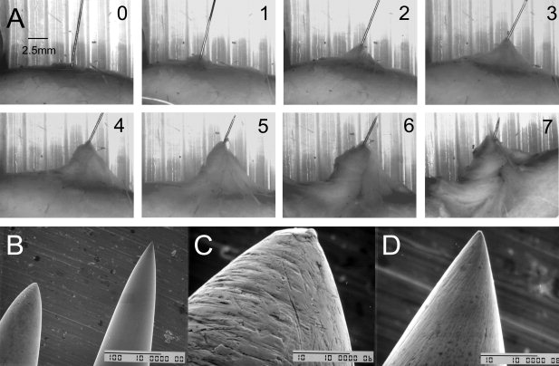
Needle Grasp

Slide 9
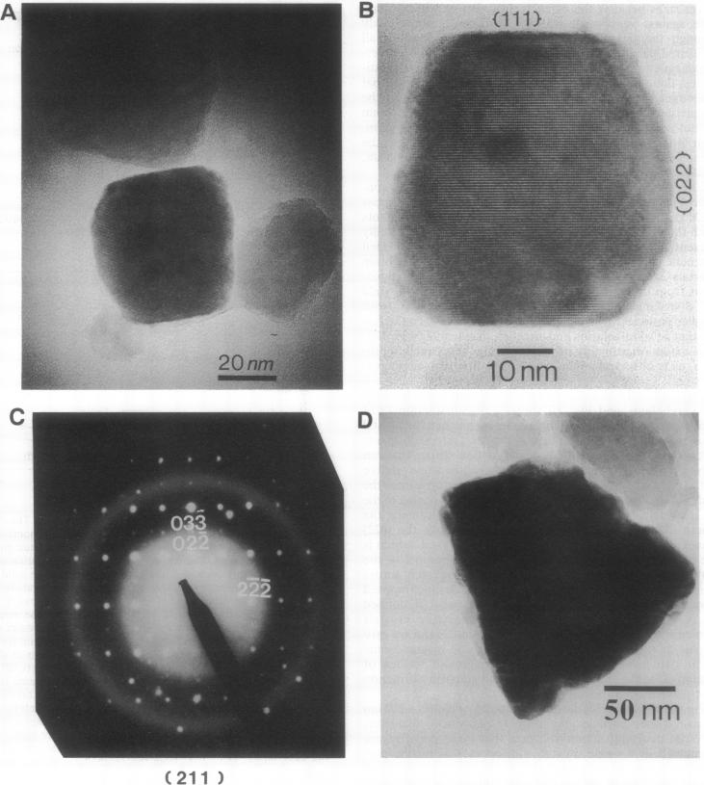
Magnetite

